Slide 1

Mapping and Analyzing Road Accidents in India using GIS
Roll : 22M1436
ES680 – Term Project
Under the guidance of Prof. Anil Kumar dixit
Indian Institute of Technology

Slide 2
iNTRODUCTION
Road accidents are a major concern in today's world, causing loss of lives and property. With the increasing number of vehicles on the road, the risk of accidents is also increasing. Therefore, it is necessary to analyze road accidents to understand their causes and to identify the hotspots where they frequently occur.
GIS can be a very crucial tool to handle and keep track all the statistics. GIS or Geographic Information System is a powerful tool for analyzing spatial data which can be integrated with many decisive factors like total road length, population of that area, total no of traffic police in that place etc.
In this project I have discussed the use of GIS in road accident analysis and demonstrate how it can be used to visualize many statistics and to identify hotspots.

Slide 3
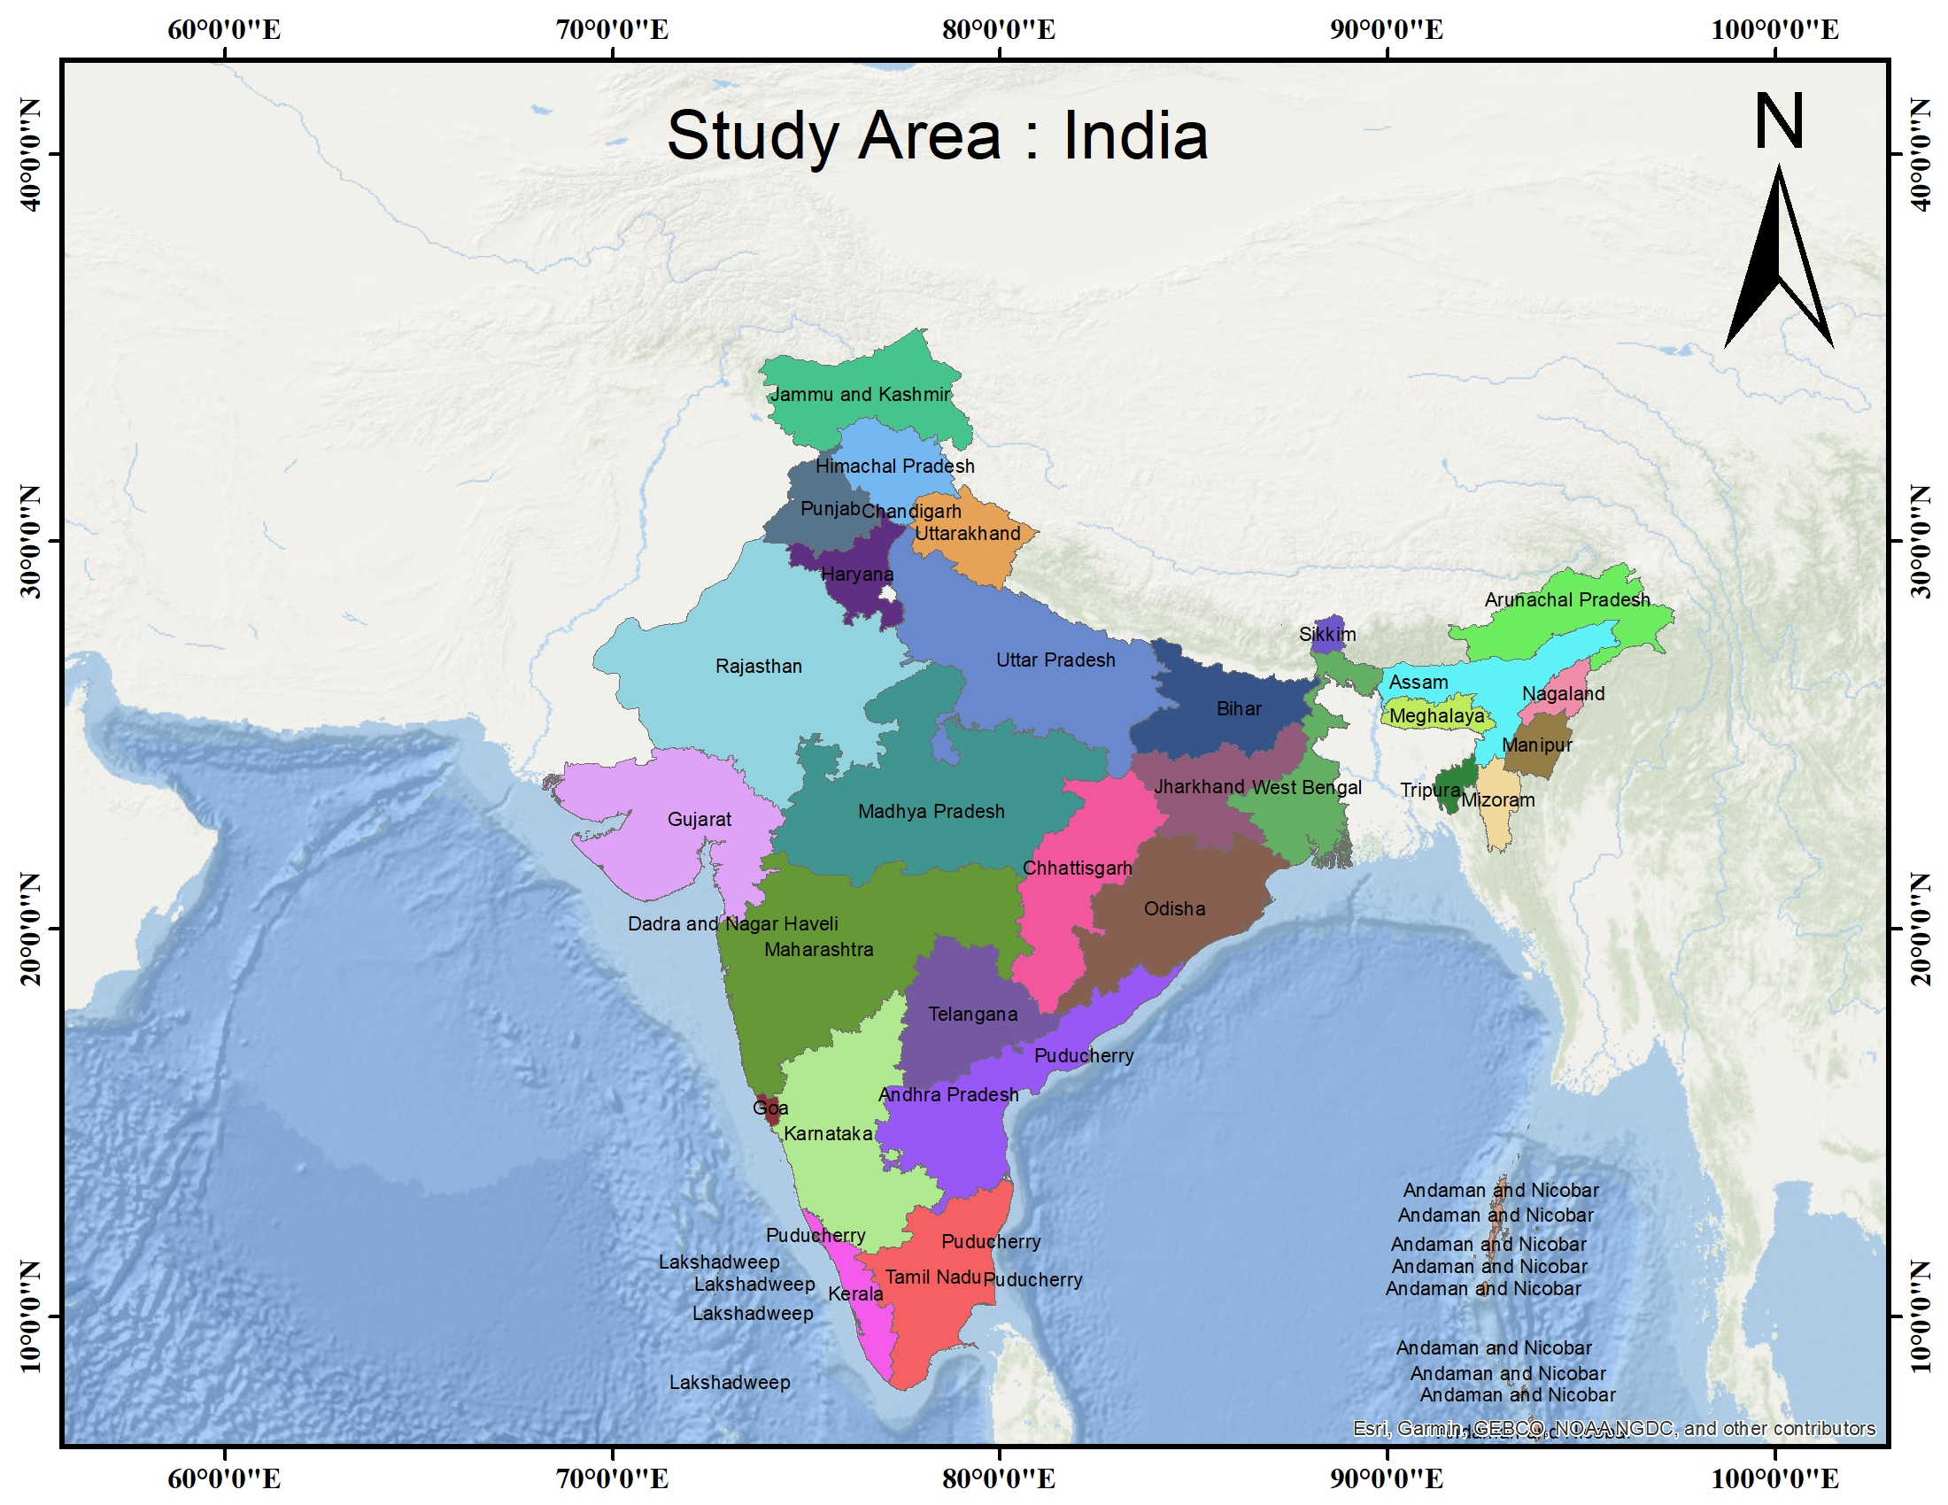
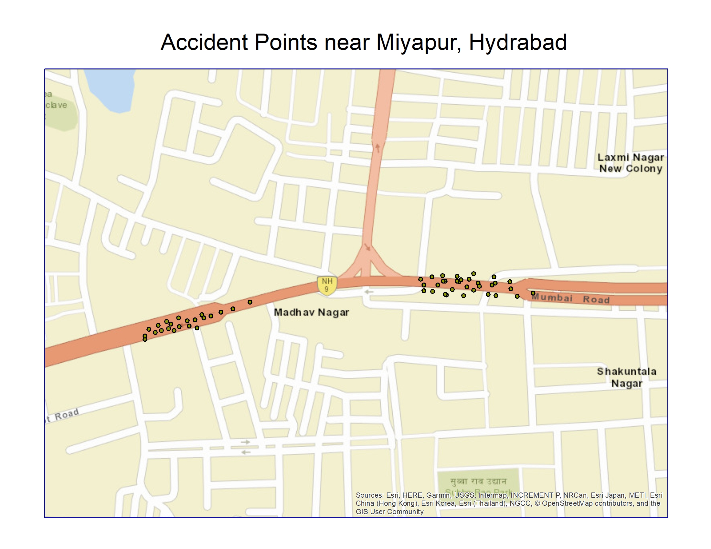
Study Area
India with its state boundary
Miyapur, Hyderabad

Slide 4
Tools and Methods
Python
GIS Tool
(ArcMap)
MS-Excel
Used for initial data cleaning process
Different symbiology visualisation of different attributes, hotspot analysis
Used for the initial analysis and initial plotting

Slide 5






Data
Road accident data: This data comprise of state wise no of fatal accident of four years
Indian Population data state wise
Road length data state wise (in km)
Total number of vehicles registered in each states
The data of number of traffic police in each state.
The accident point coordinate in Miyapur, Hyderabad

Slide 6
Method and steps
Collect the data for road length, population, registered vehicles, and number of traffic police from reliable sources.
Collect the shape file for India from a reliable source.
Load the data in ArcMap and ensure that it is in the correct format.
Dissolve the Shape file on the same state name or UT name to create a new shapefile with a single polygon for each state or UT.
Join the attribute table on the name of the states to add the data to the shapefile.
Use different symbology for different years and attribute fields to create maps and visualizations.
Identify the area with the highest risk of road accidents by calculating the area per kill using a hotspot tool to highlight these states.
66

Slide 7
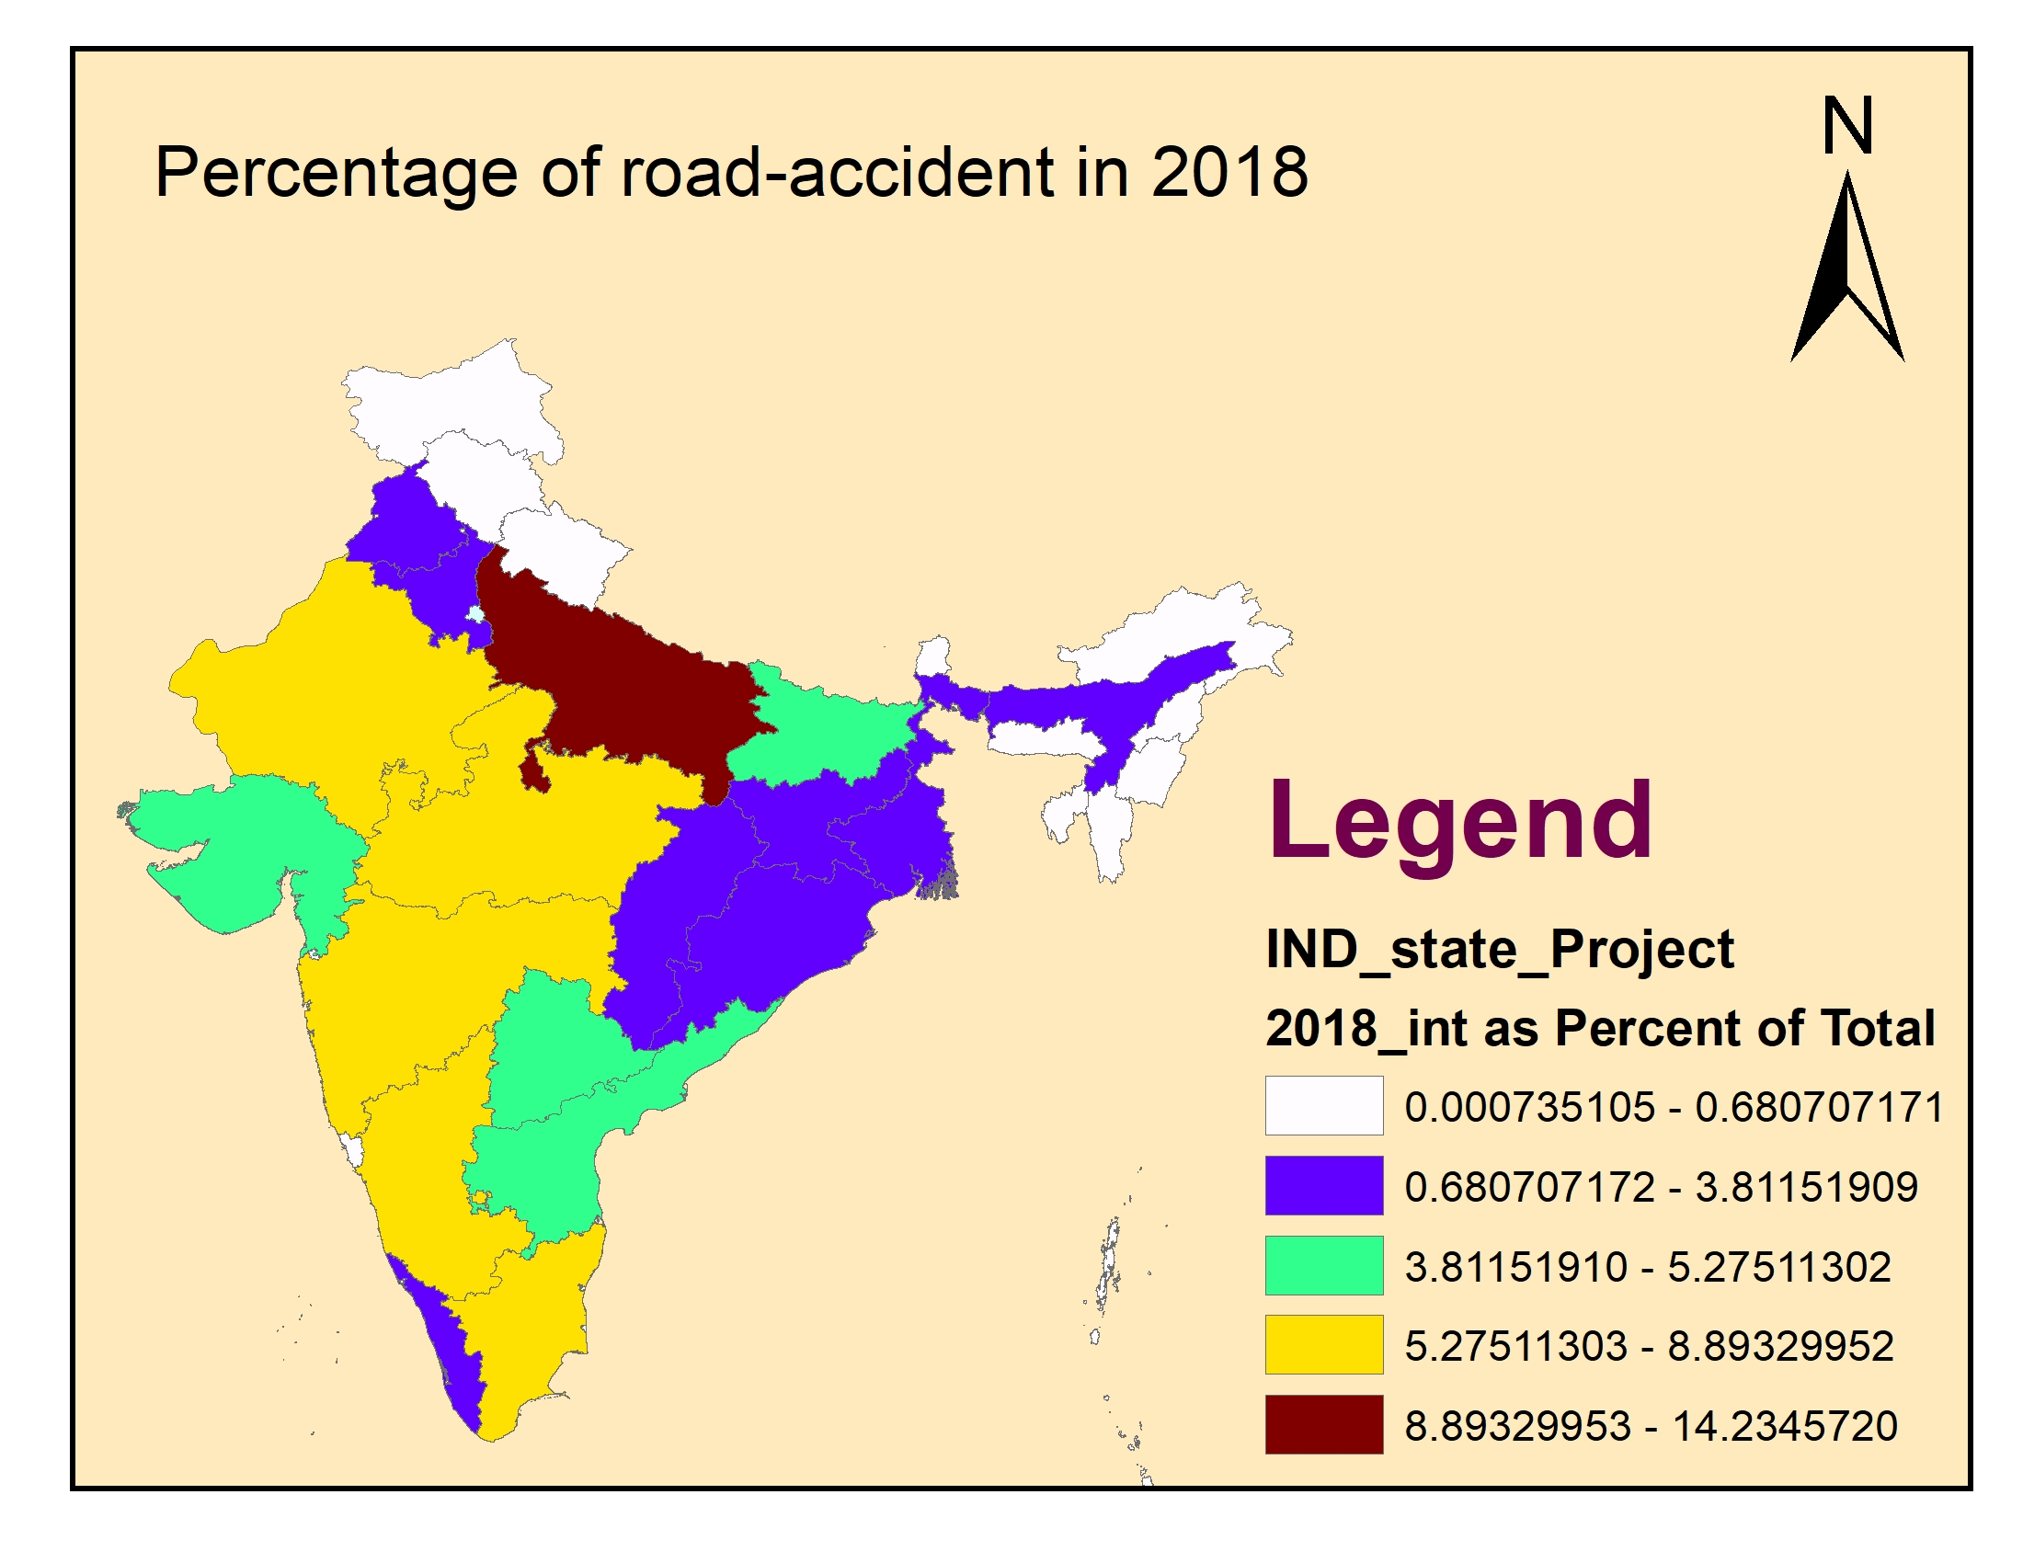
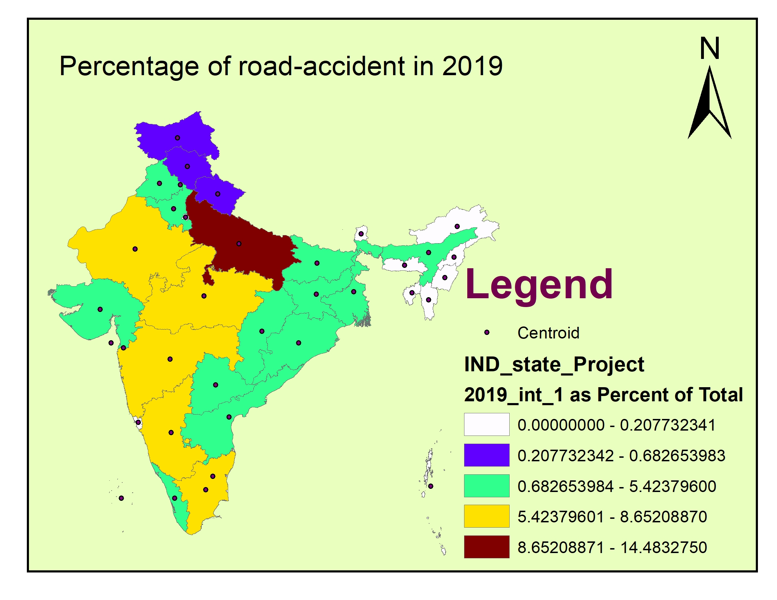
REsults
Percentage of the total accident in different years:
Total accident : 136035
Rank: Uttar Pradesh, Maharashtra, Tamil Nadu
Total accident : 135842
Rank: Uttar Pradesh, Tamil Nadu, Maharashtra,

Slide 8
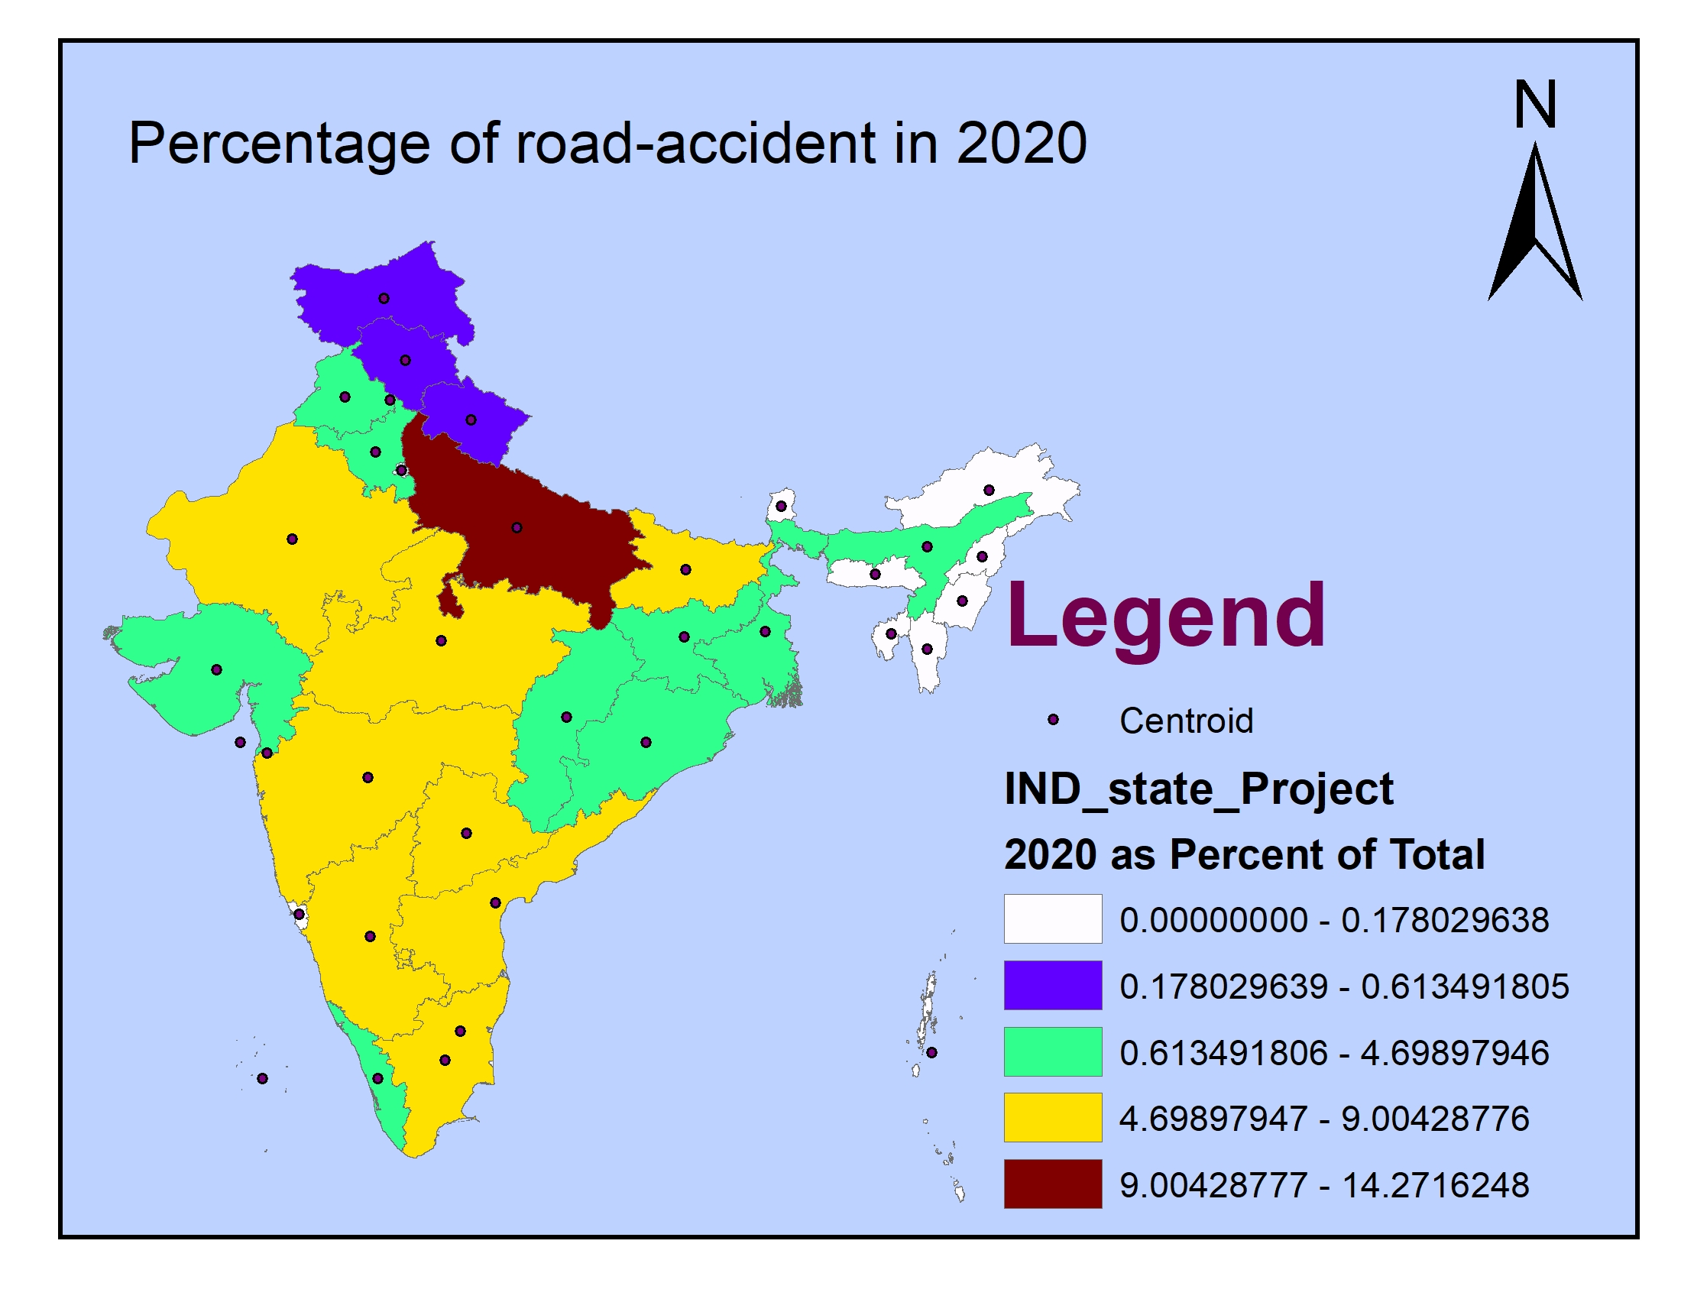
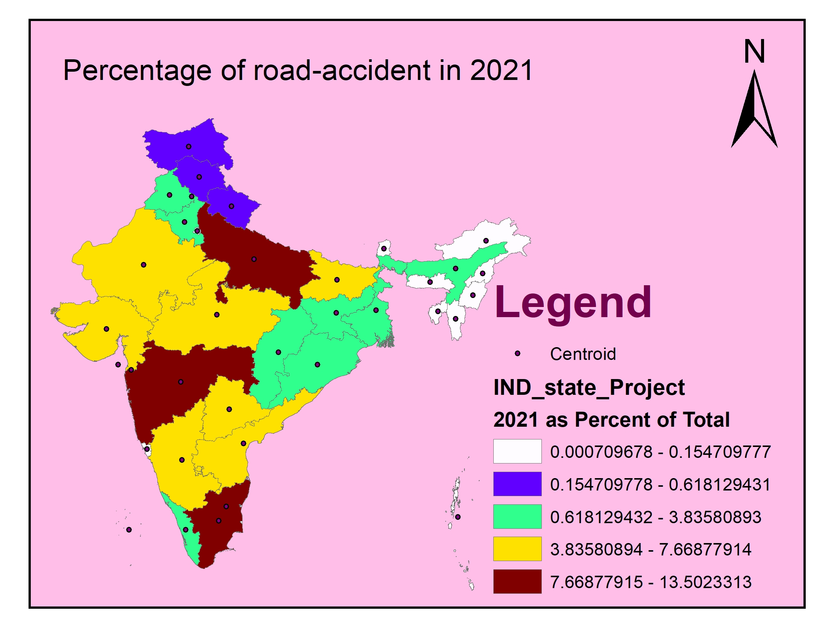
REsults
Percentage of the total accident in different years:
Total accident : 120110
Rank: Uttar Pradesh, Maharashtra, Madhya Pradesh
Total accident : 140322
Rank: Uttar Pradesh, Tamil Nadu, Maharashtra,

Slide 9
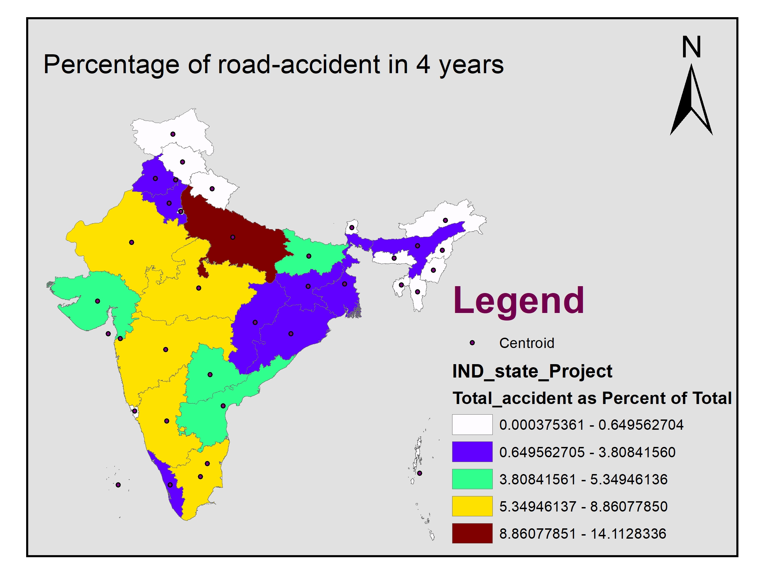
REsults
Percentage of the total accident in different years:
Rank: Uttar Pradesh, Maharashtra, Tamil Nadu

Slide 10
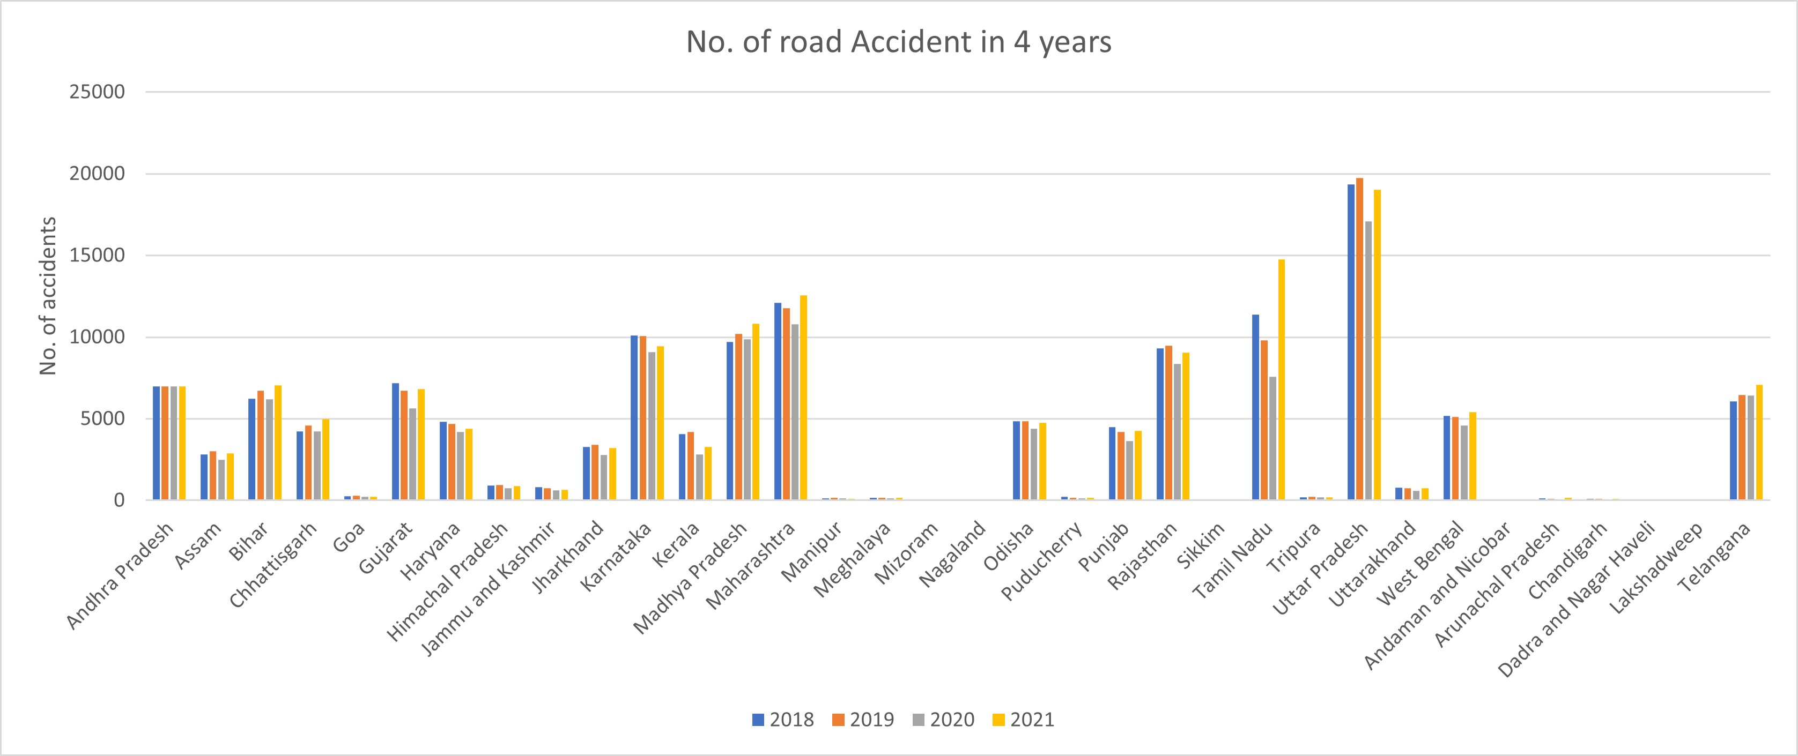
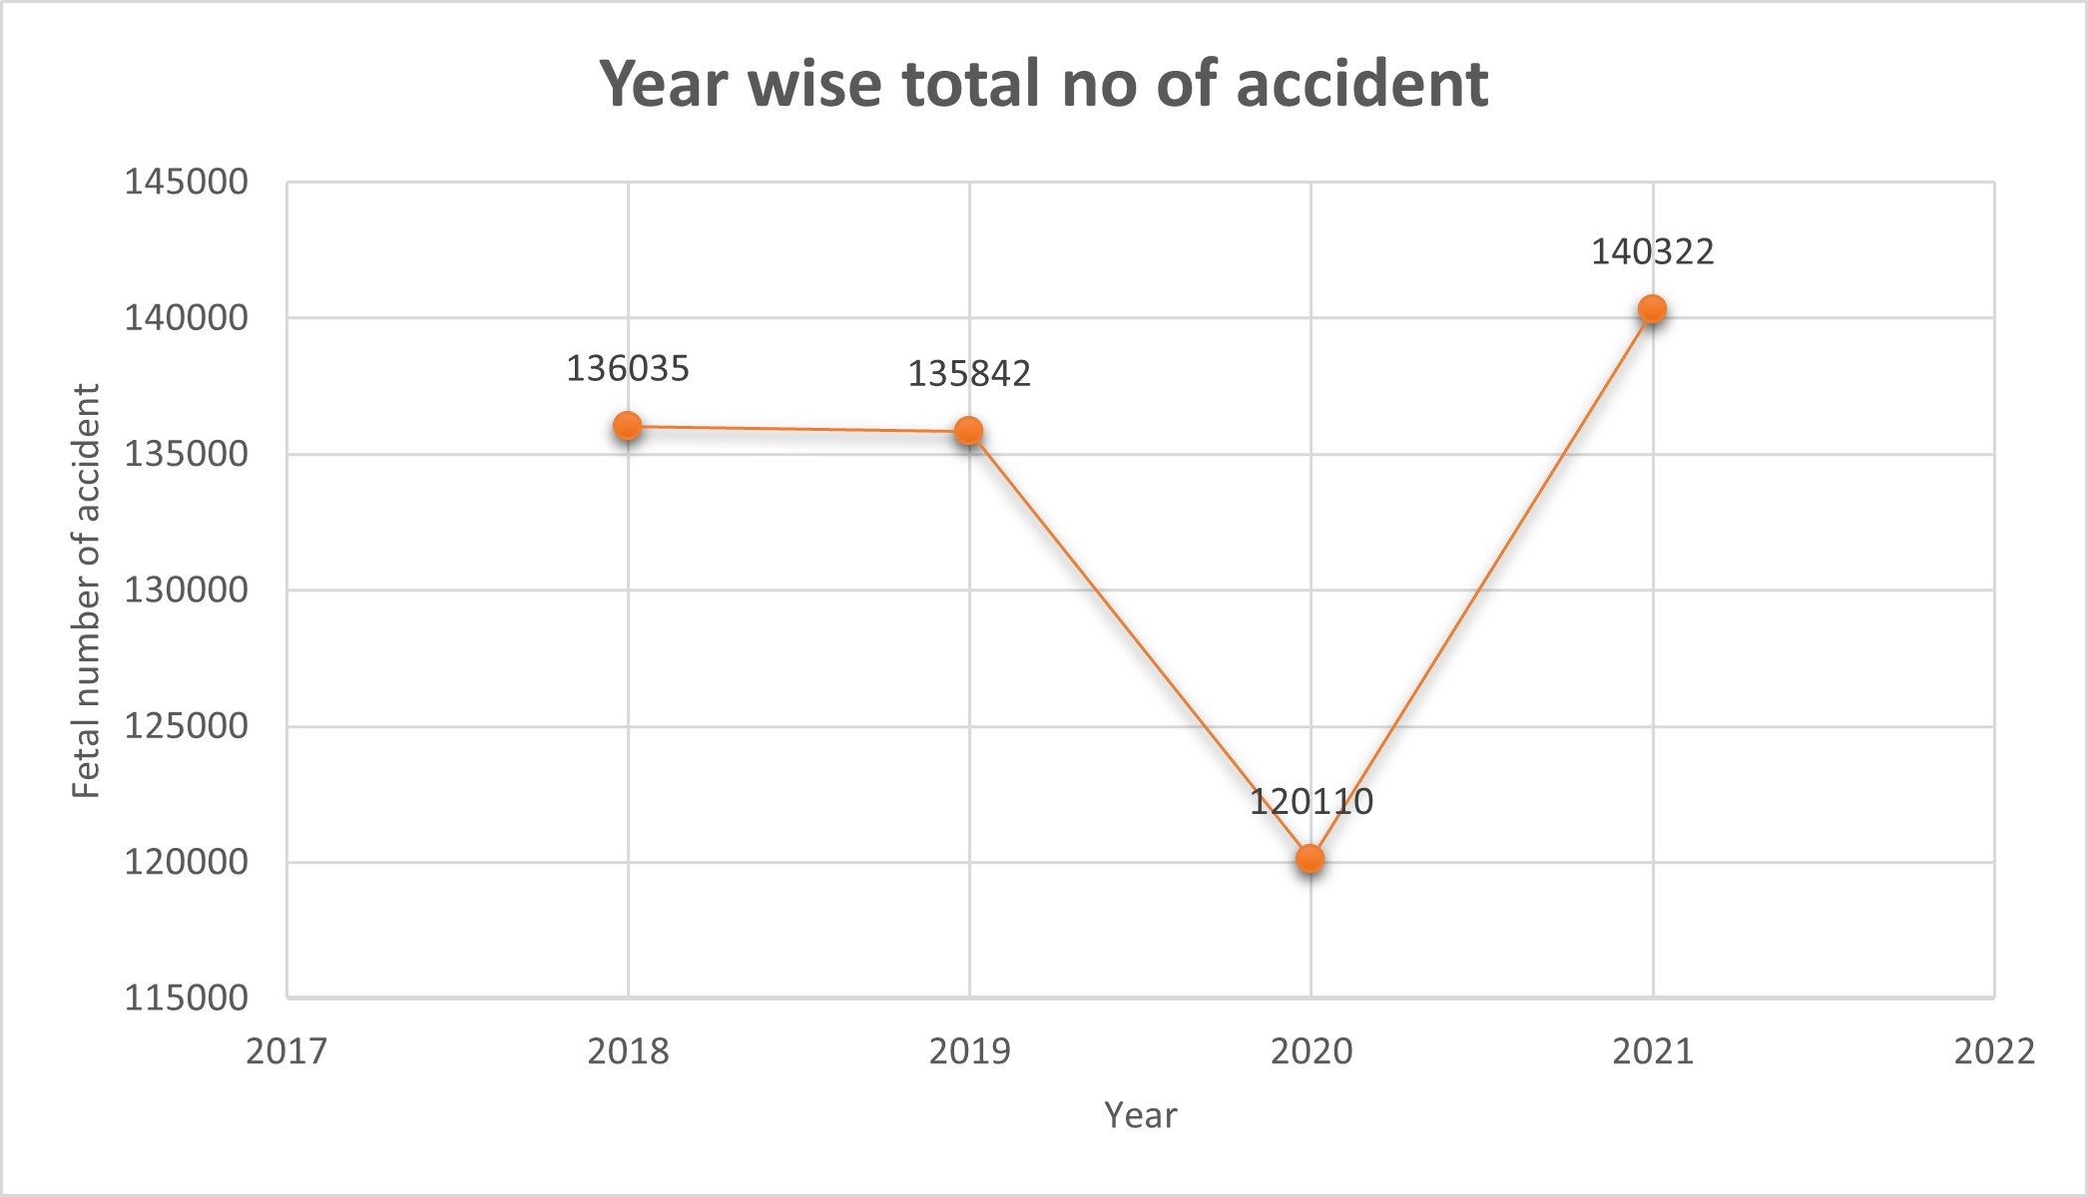
REsults
Comparison between four years:
There is a clear declamation in 2020 because Lockdown

Slide 11
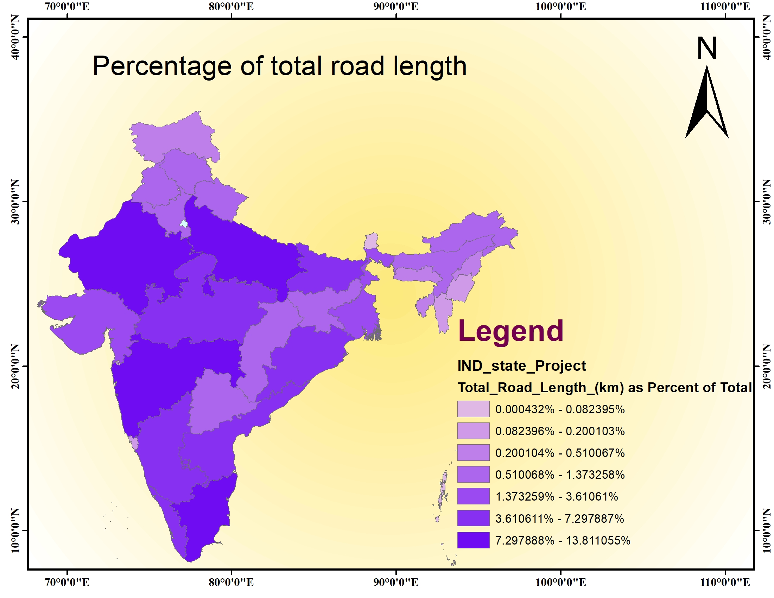
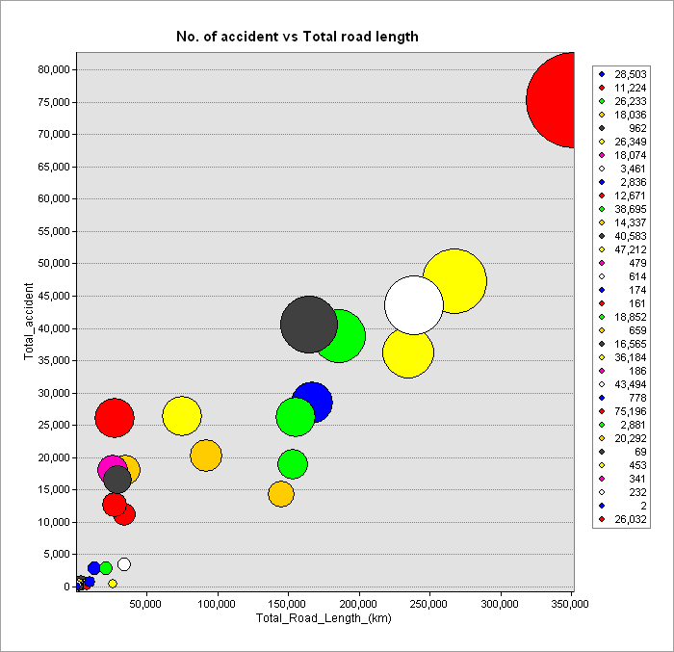
REsults
Effect of total road length:
The top states with most no. of accident have more total road length

Slide 12
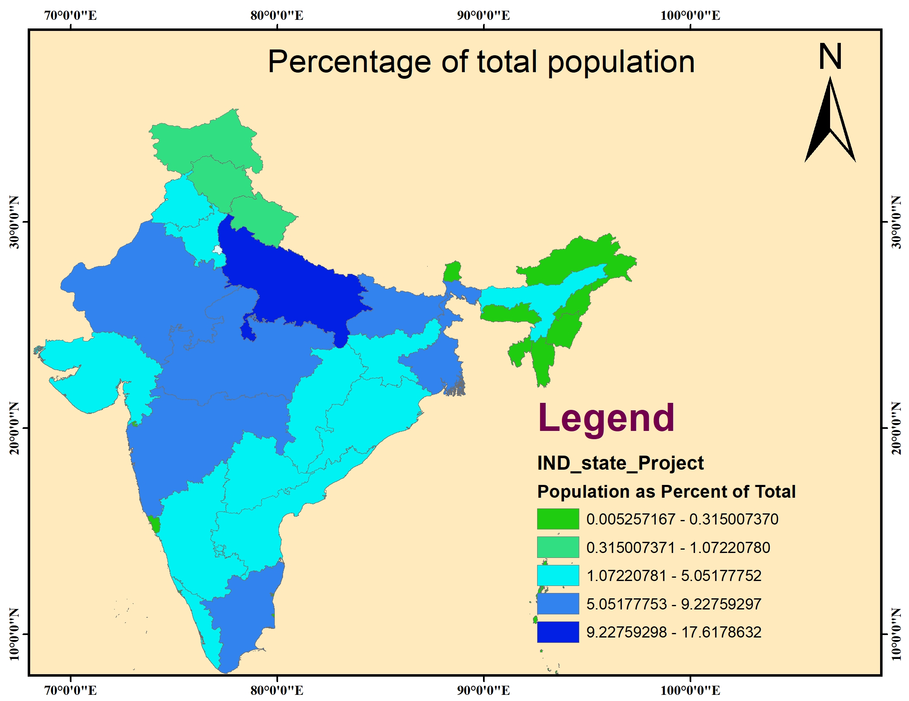
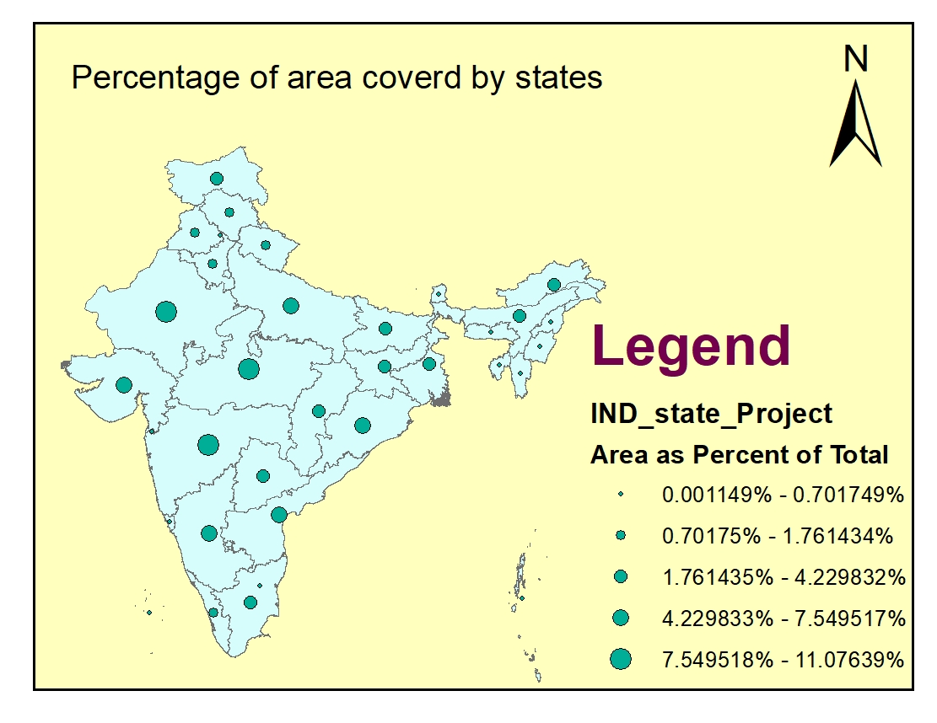
REsults
Effect of papulation and population density:
From this figure we can observe that states have more number of accident have more population also.

Slide 13
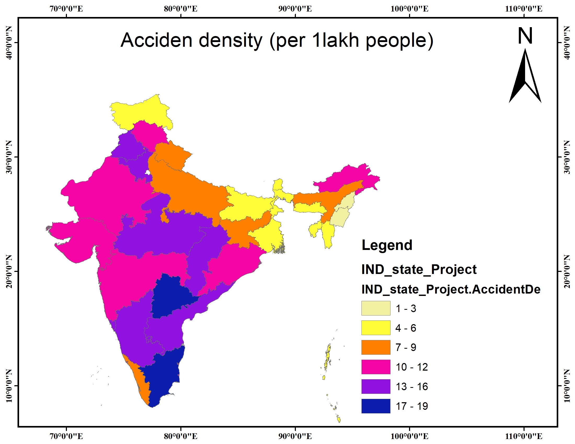
REsults
Effect of papulation and population density:
Tamil Nadu and Telangana have most no. of fatal accidents per 1 lakh people

Slide 14
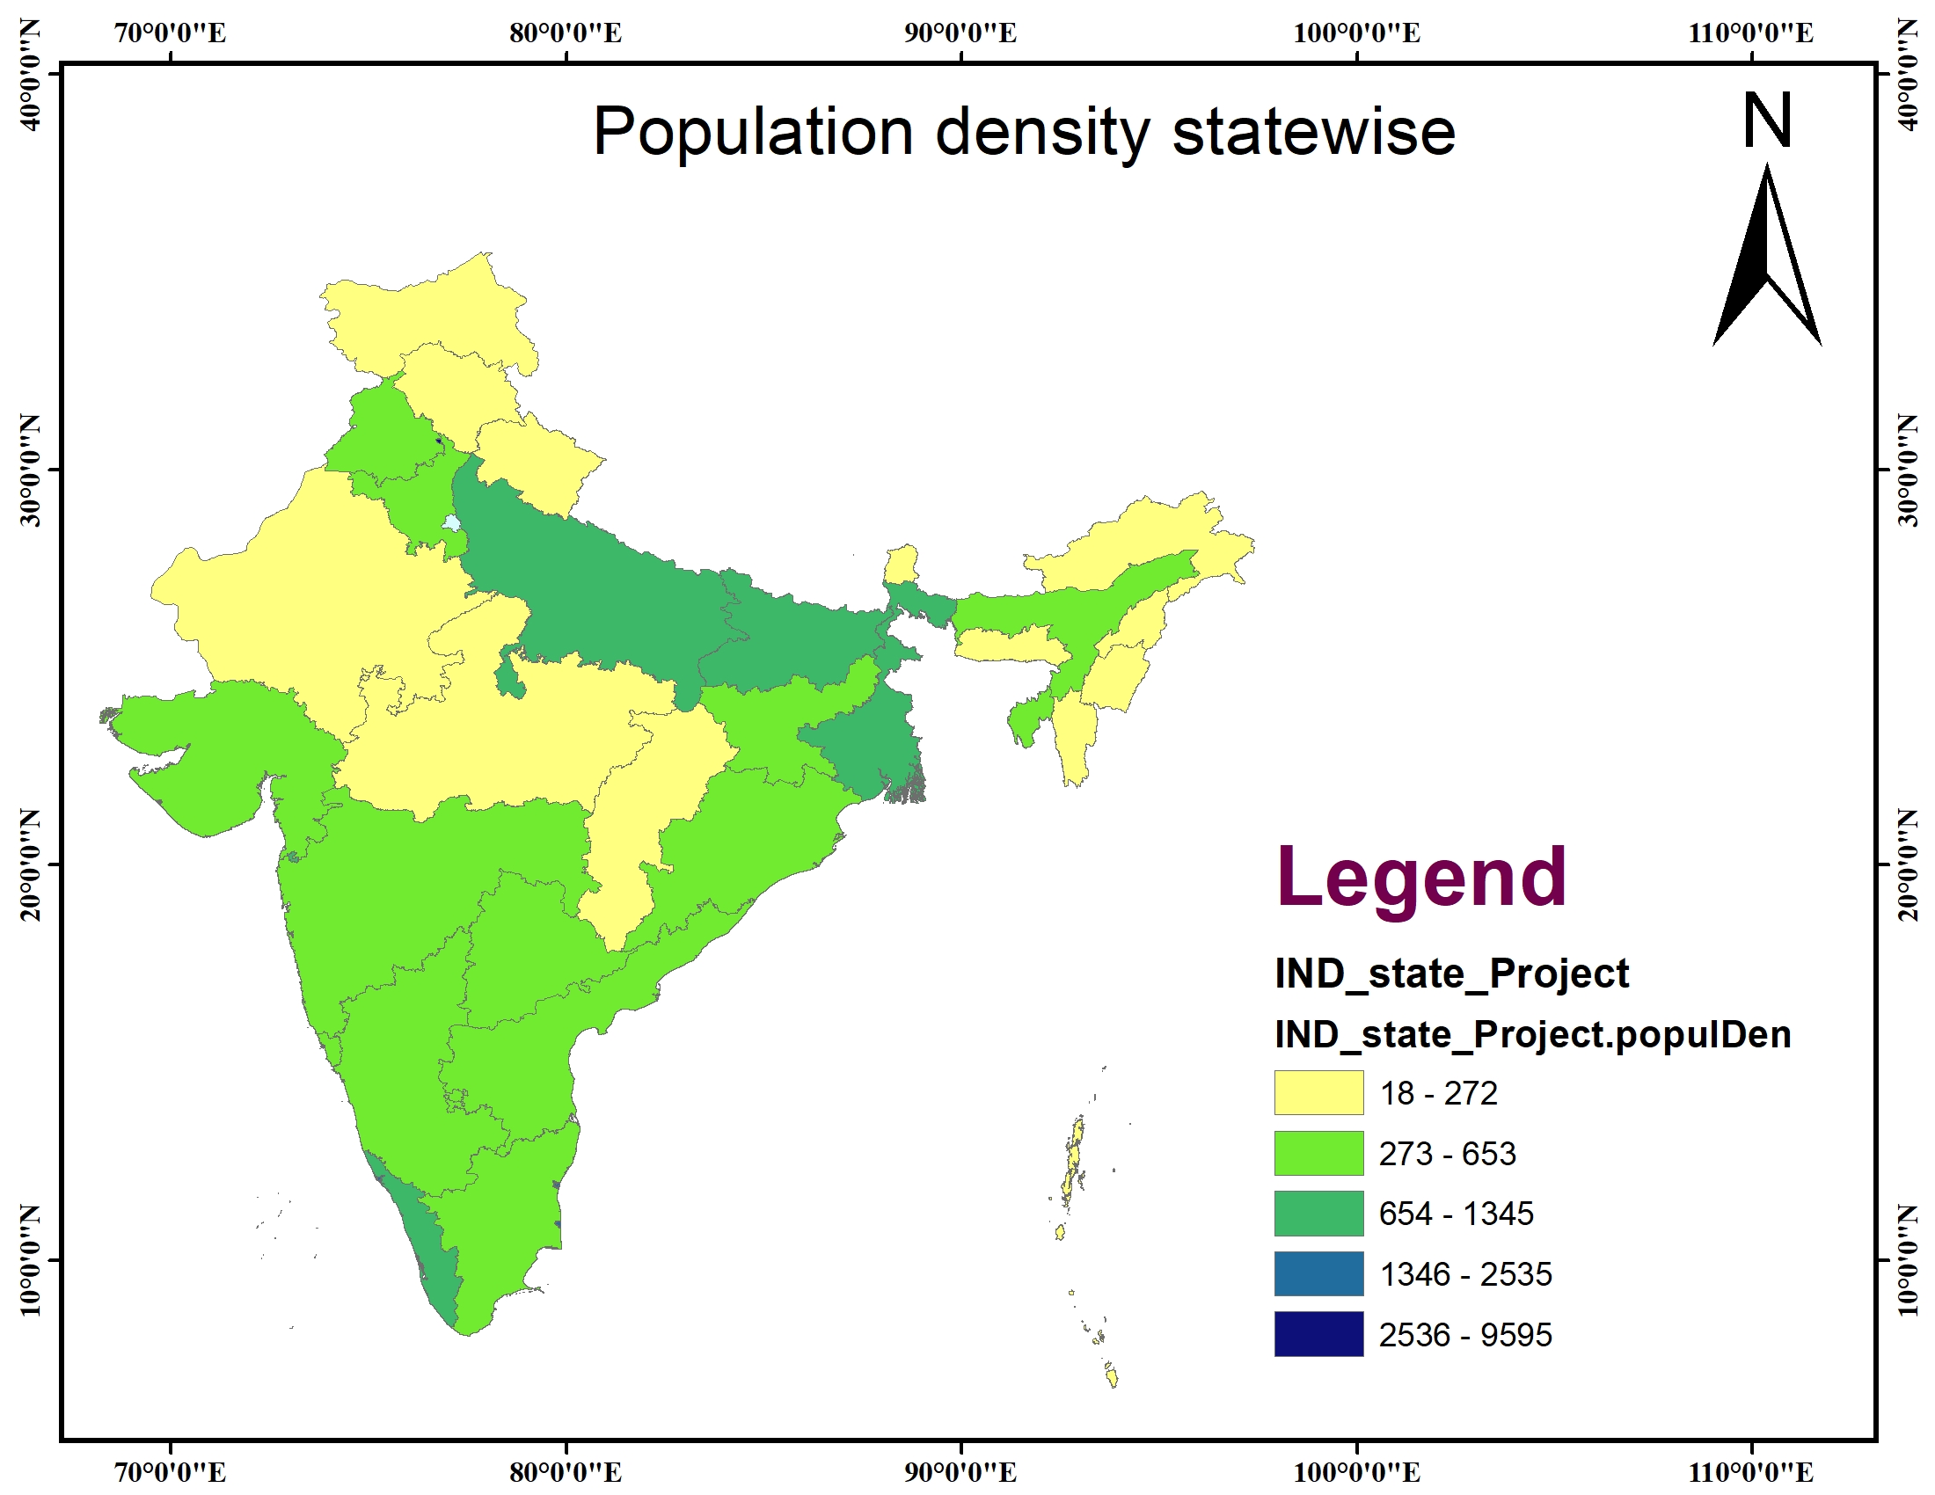
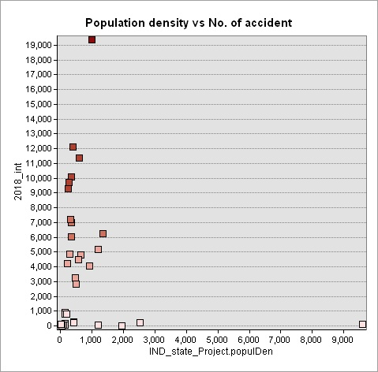
REsults
Effect of papulation and population density:
Some states has high population density but less number of accident

Slide 15
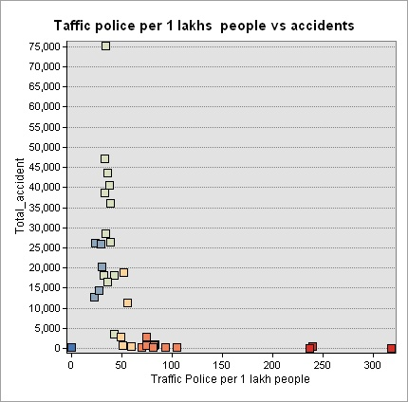
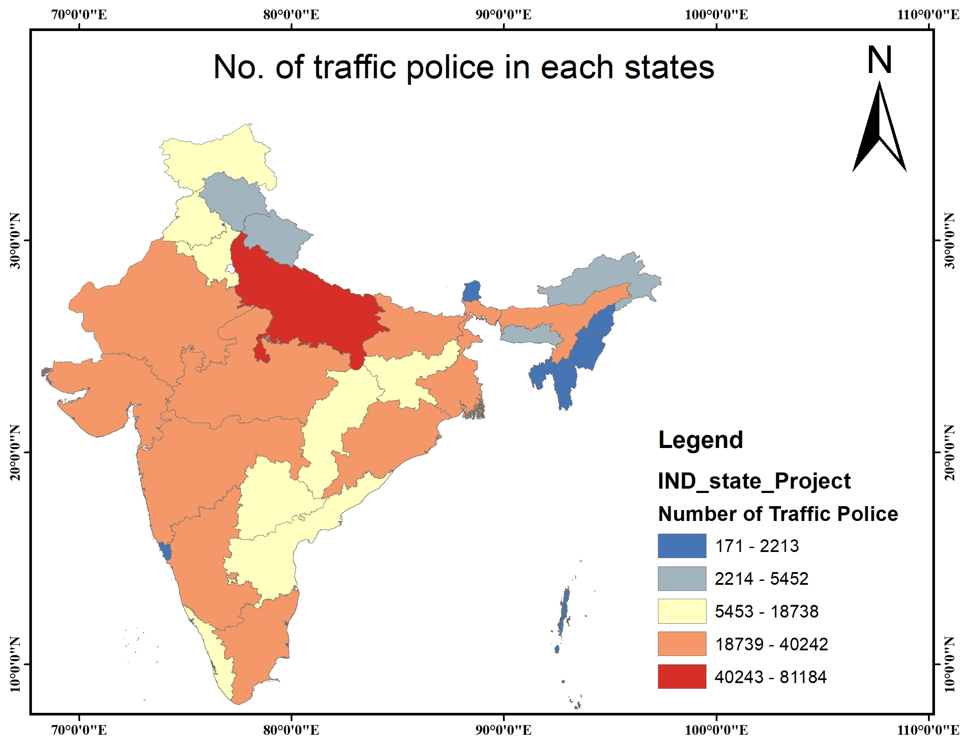
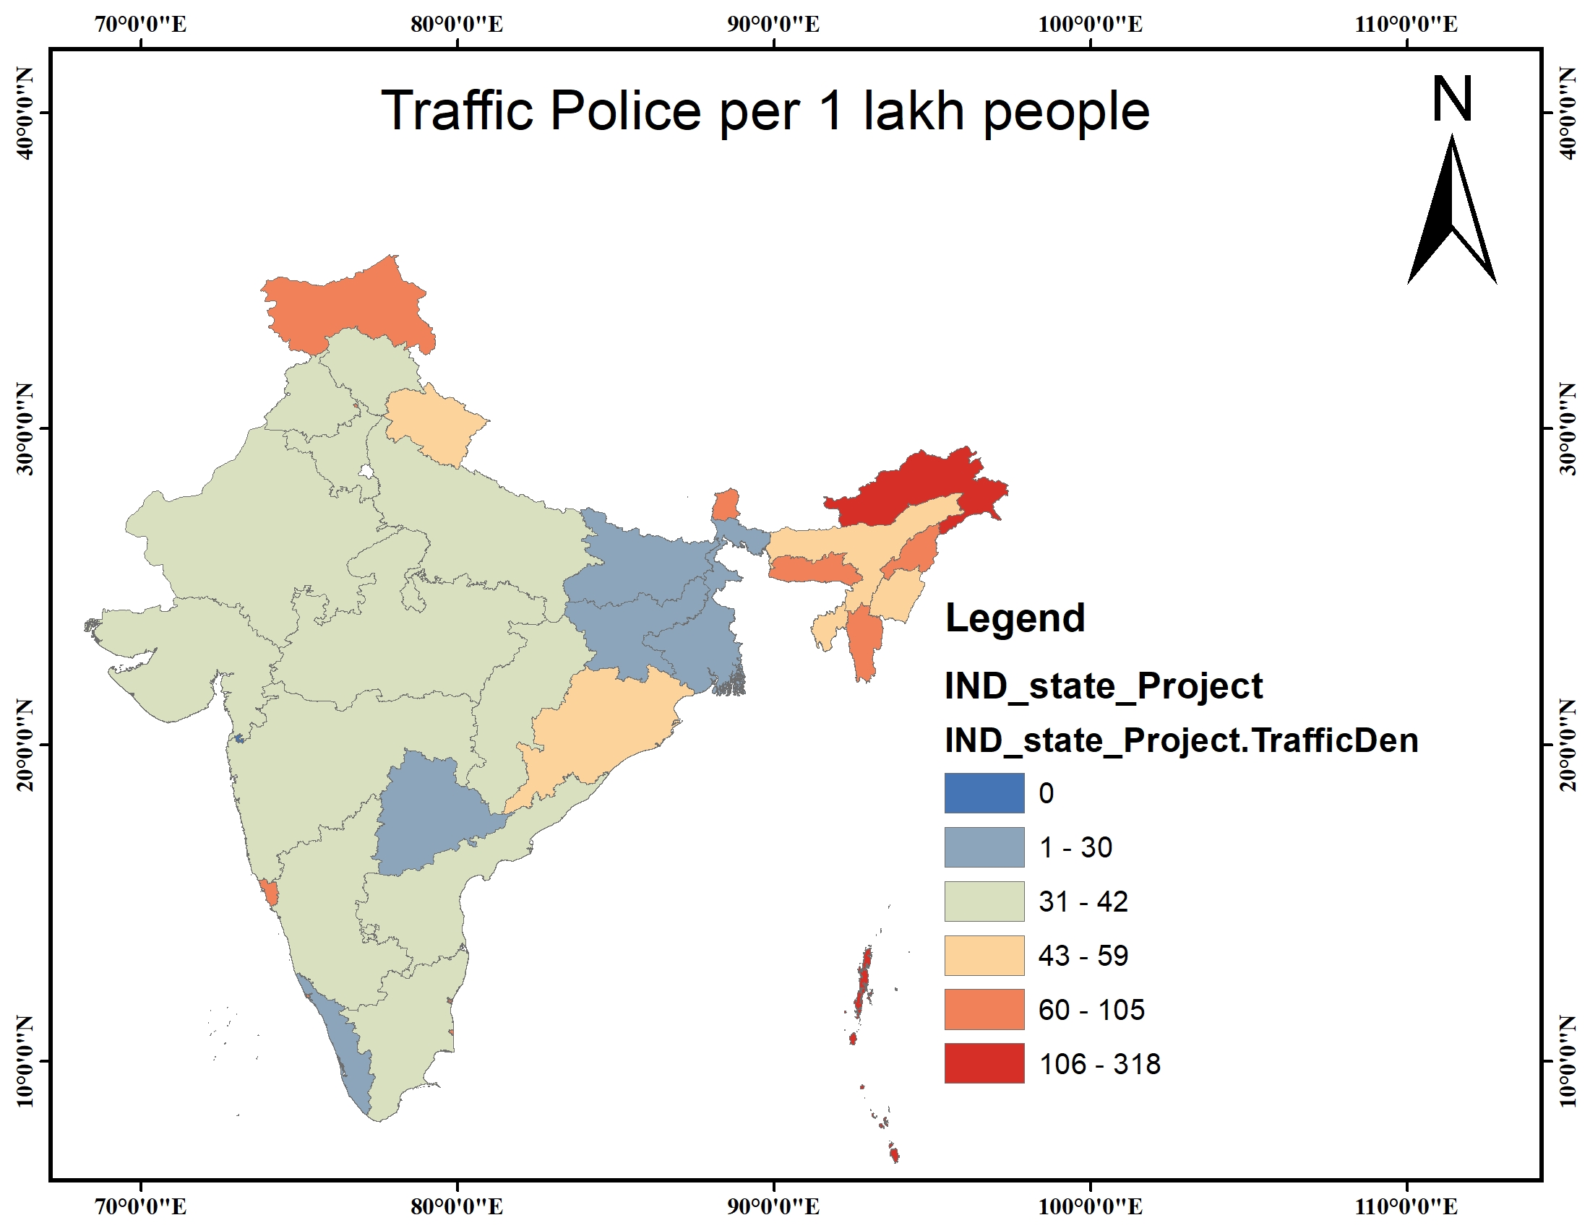
REsults
From the context of no. of traffic police:
Total no of traffic police should not be the parameter as above a threshold of no. of traffic police the accident number are very less

Slide 16
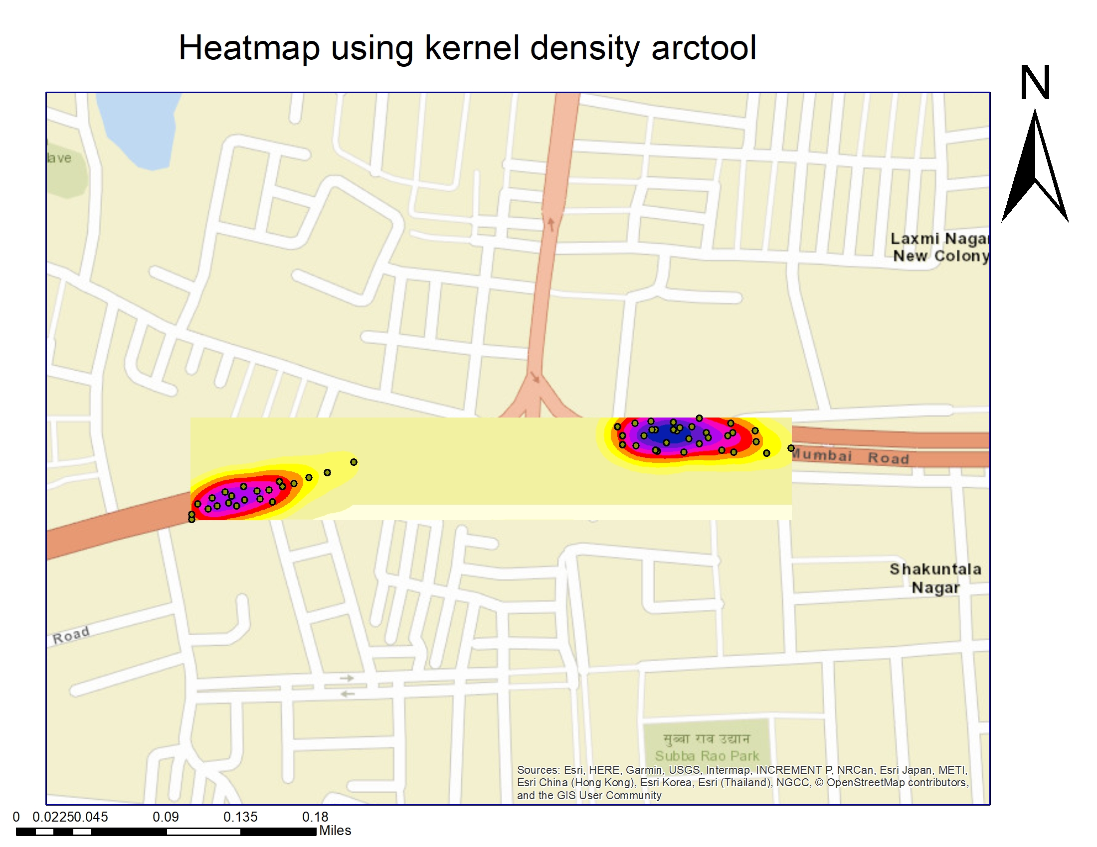
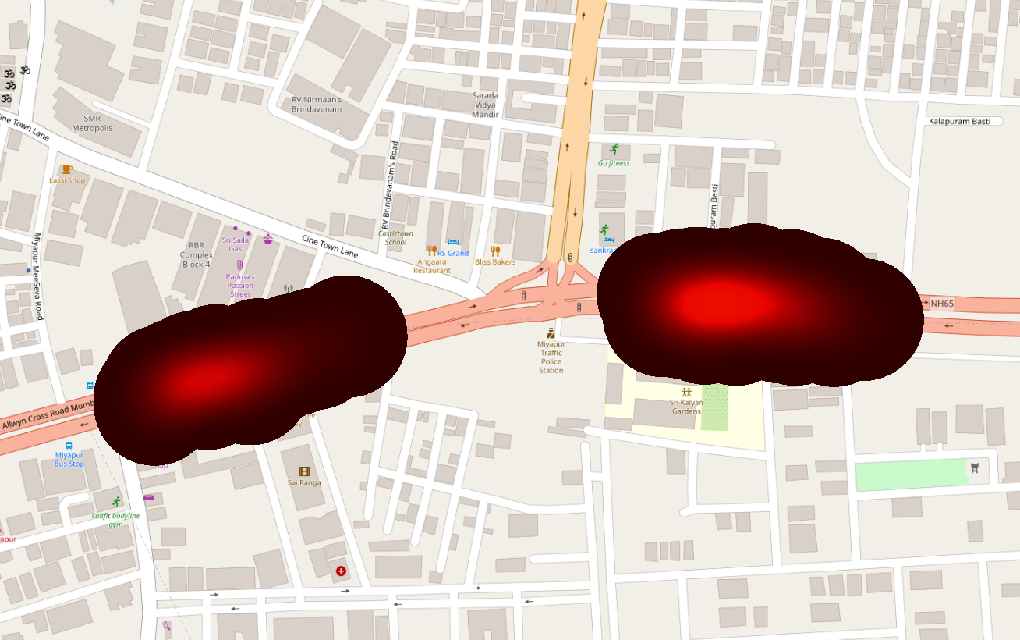
REsults
Hotspot analysis:
This is the study area of Miyapur, Hyderabad, where the Kernel density tool is used and it is showing the heat map of the risky zone around 50 meter radius

Slide 17
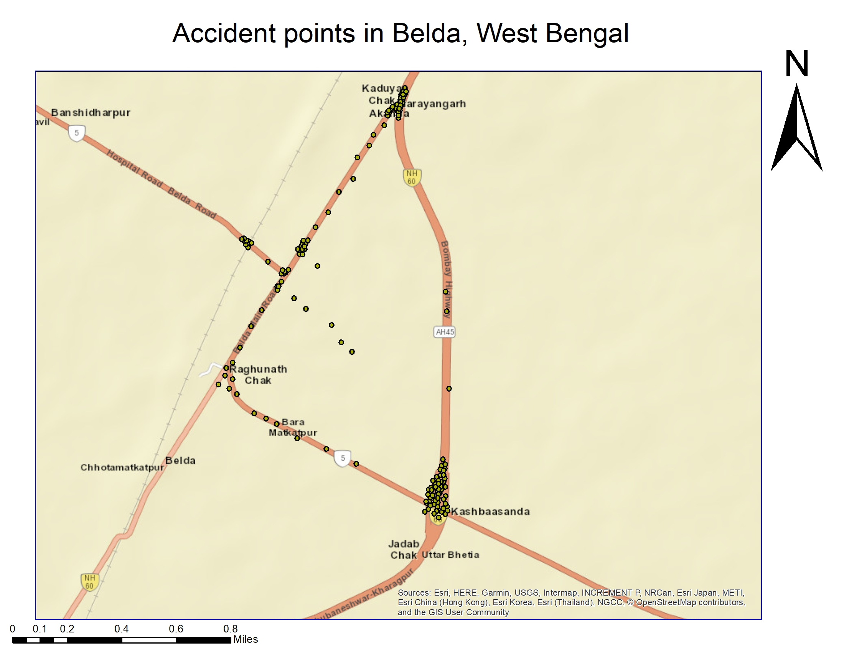
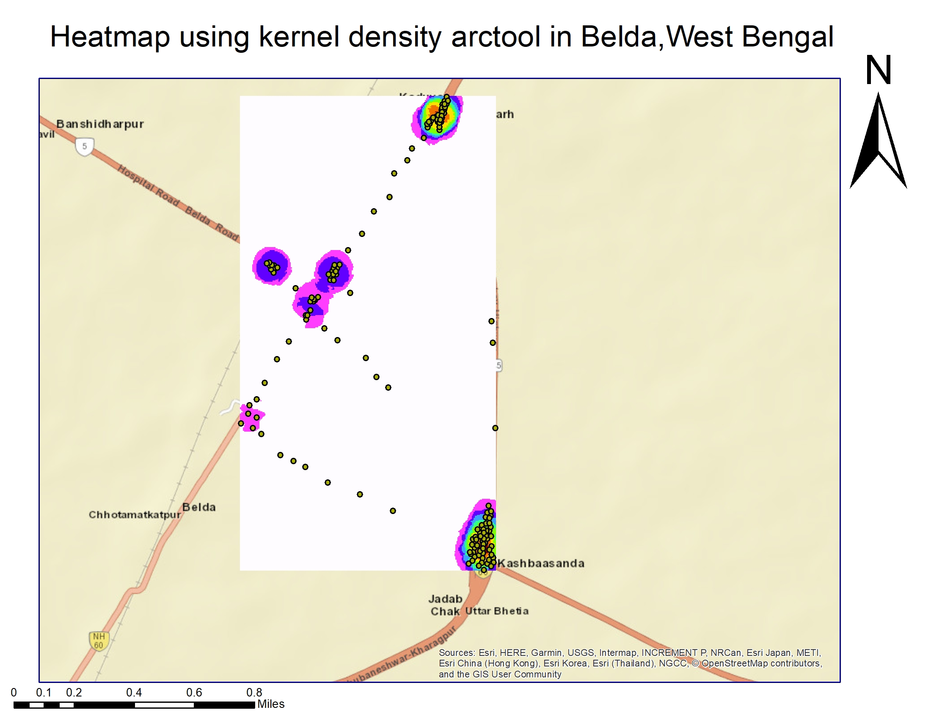
REsults
Hotspot analysis:
This is the study area of Belda, West Bengal where the Kernel density tool is used and it is showing the heat map of the risky zone around 100 meter radius

Slide 18
Conclusion
In conclusion we can say there can be more plenty of things can be done using GIS tools in road accident reduction and road safety measures like:-
Accident prone zone area notification in online mapping services.
Database manage of road accidents and road safety .
Can be found more effective and risk free root way for prevent road accidents by feeding the shapes of the roads.

Slide 19
Reference
Esri documentation: Up-to-date documentation for arcgis and more. (n.d.). https://doc.arcgis.com/en/
India population. (n.d.). https://www.populationu.com/india-population Khan, M., Mir, I., Faheem, M. I., & Aquil, M. (2018). Gis based spatial analysis of urban trafficaccidents. 8, 270–279.
Netek, R., Pour, T., & Slezakova, R. (2018). Open Geosciences, 10(1), 367–384. https://doi.org/doi:10.1515/geo-2018-0029
Road accident in india,2021. (2022). 8, 270–279.
Singh, S. K. (2017). Road traffic accidents in india: Issues and challenges [World Conference on
Transport Research - WCTR 2016 Shanghai. 10-15 July 2016]. Transportation Research Procedia, 25, 4708–4719. https://doi.org/https://doi.org/10.1016/j.trpro.2017.05.484

Slide 20
Thank You

